Slide 1
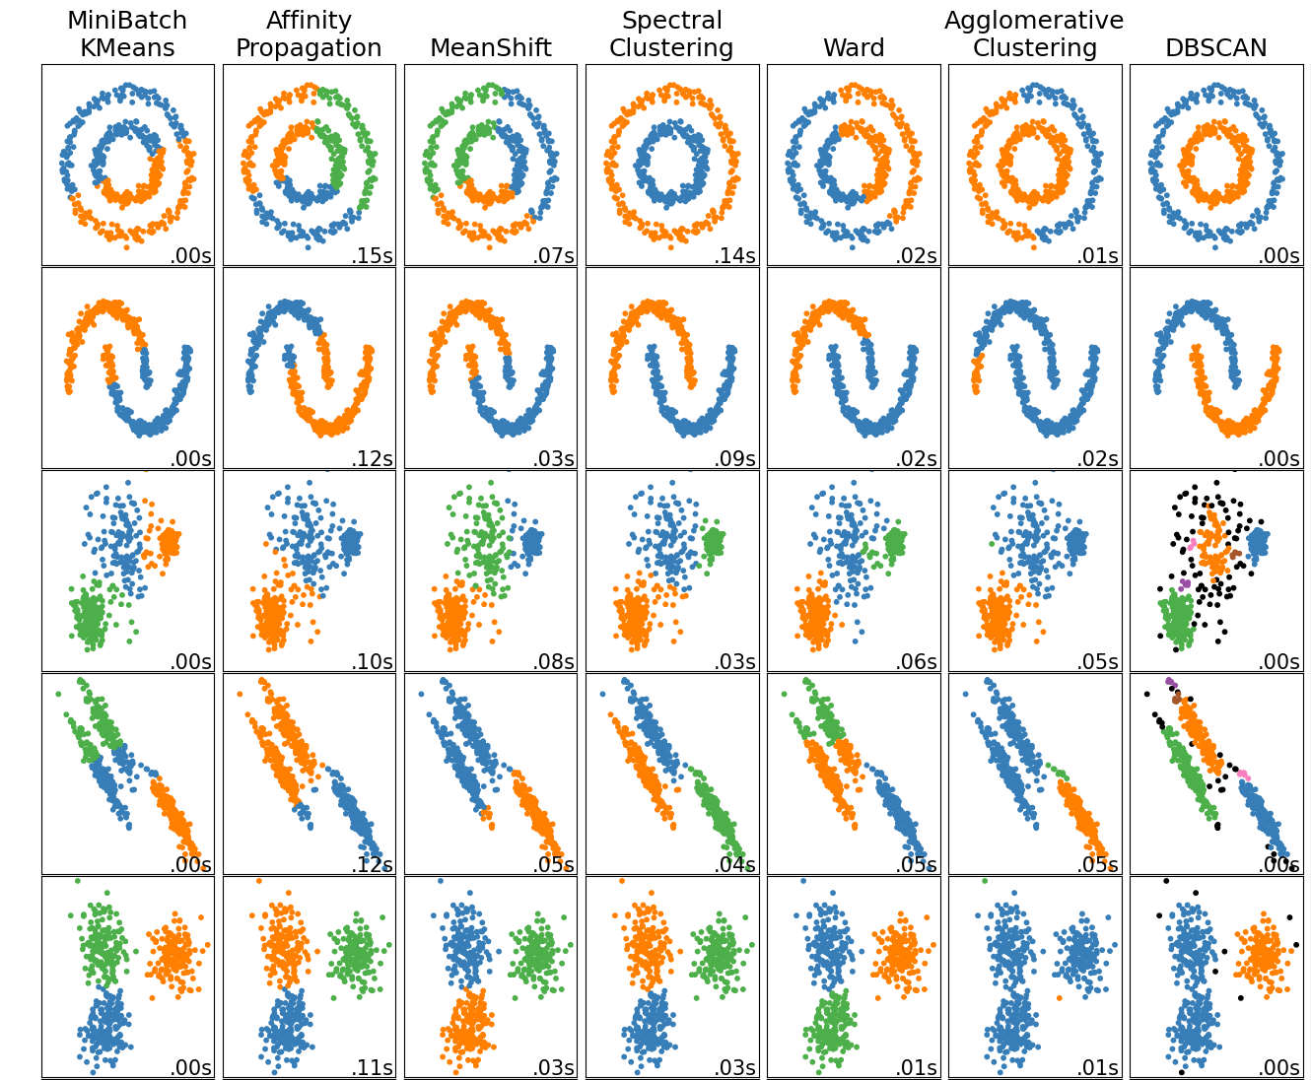
Unsupervised Learning Part 3: Density-based Clustering

Slide 2
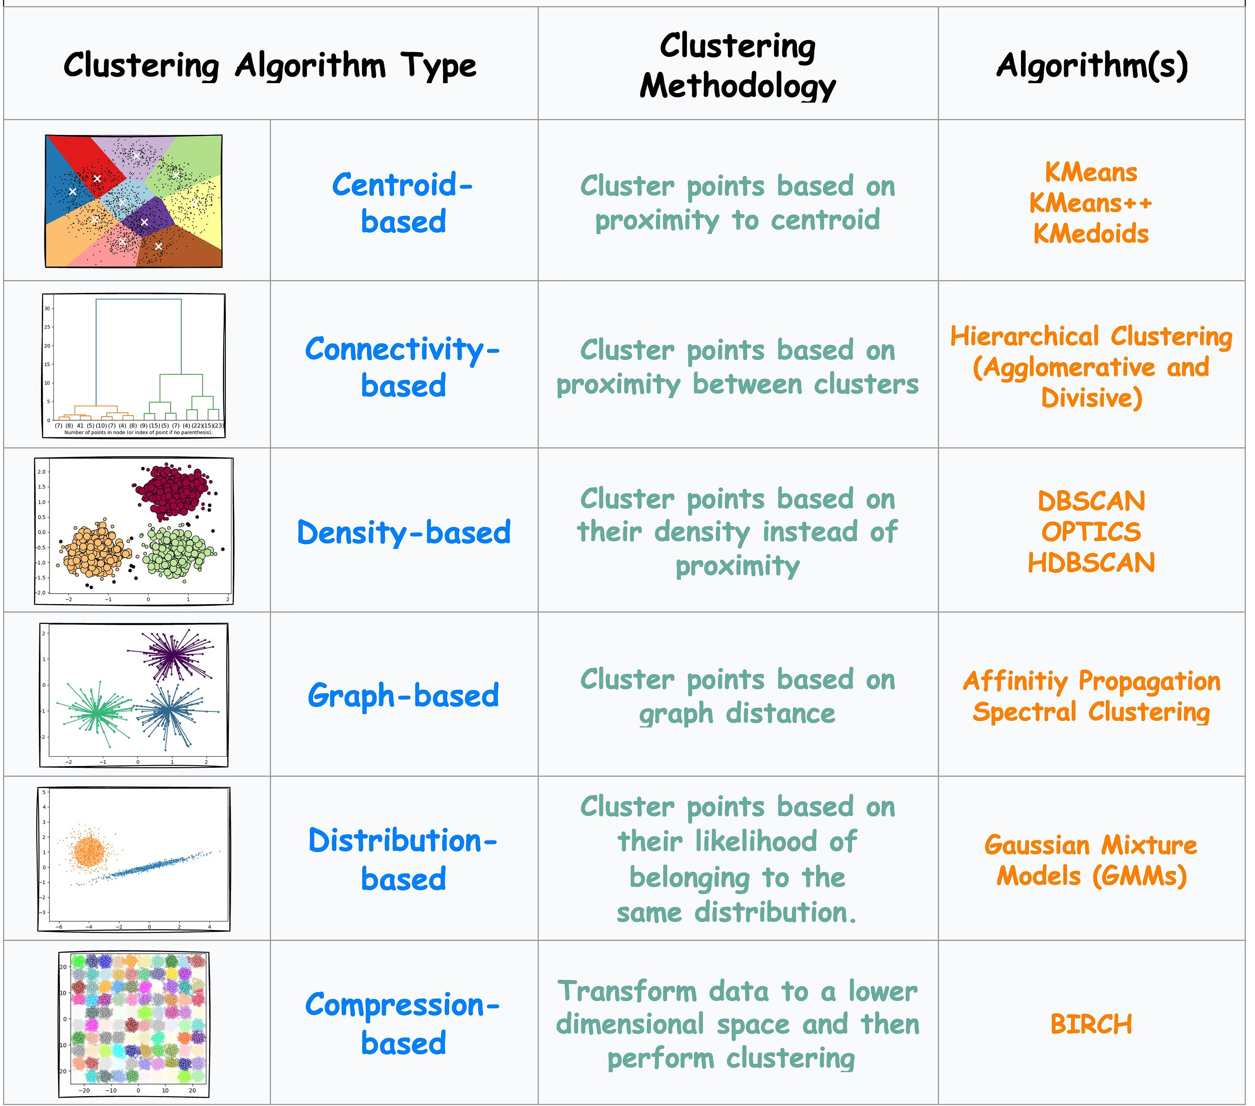

Outline
Hierarchical Clustering
Agglomerative
Divisive
Density Based Clustering
DBSCAN

Slide 3
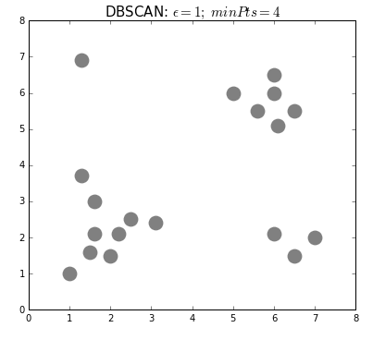
DBSCAN Algorithm
DBSCAN (Density-Based Spatial Clustering of Apps w Noise)
Pick hyperparamters: ε and min. points.
Pick any unvisited point. Find its neighbors within a specified distance (ε).
If there are enough neighbors (at least minPts), start a new cluster. Otherwise, mark it as noise.
Add all neighbors to the cluster. Expand the cluster by checking each new point’s neighbors and adding them if they qualify.
Repeat until no more points can be added to the cluster.
Move to the next unvisited point and repeat the process until all points are either clustered or marked as noise
Notes:
DBSCAN requires only two parameters: epsilon and minPoints. Epsilon is the radius of the circle to be created around each data point to check the density and minPoints is the minimum number of data points required inside that circle for that data point to be classified as a Core point.
In higher dimensions the circle becomes hypersphere, epsilon becomes the radius of that hypersphere, and minPoints is the minimum number of data points required inside that hypersphere.

Slide 4
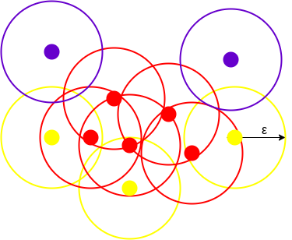
Density Based Clustering - DBSCAN
Density: The number of points within a specified radius (Eps).
Core Point: Has at least MinPts within Eps (interior of a cluster).
Border Point: Has fewer than MinPts within Eps but is near a core point.
Noise Point: Neither a core point nor a border point.
The above figure shows us a cluster created by DBCAN with minPoints = 3. Here, we draw a circle of equal radius epsilon around every data point.

Slide 5
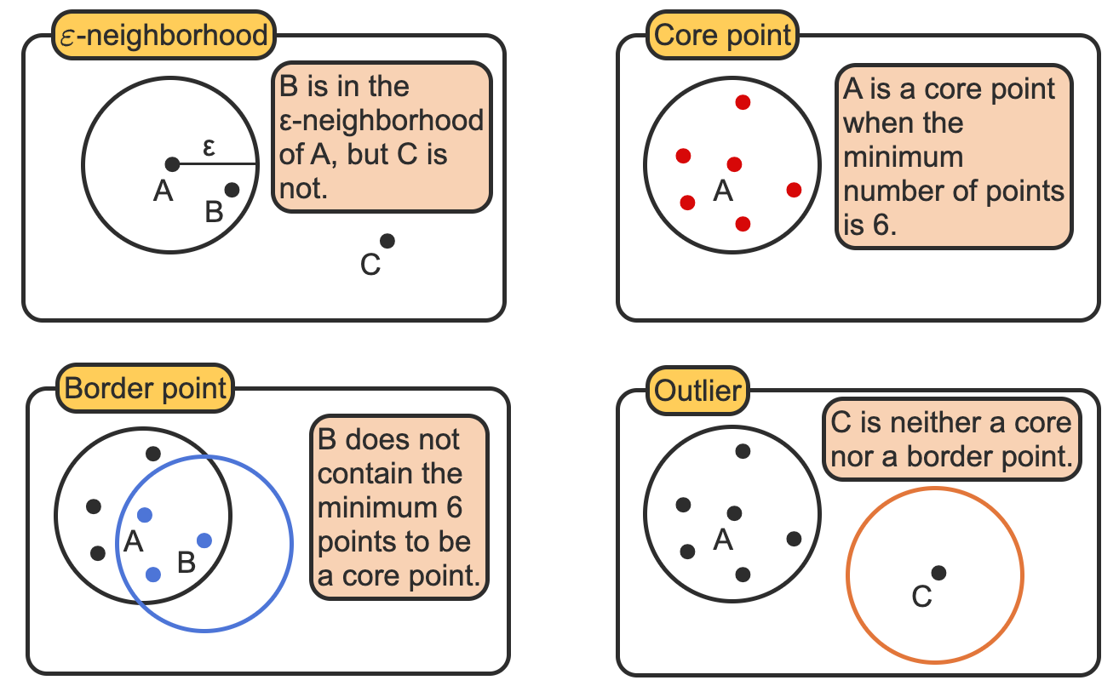
DBSCAN DEfinitions

Slide 6
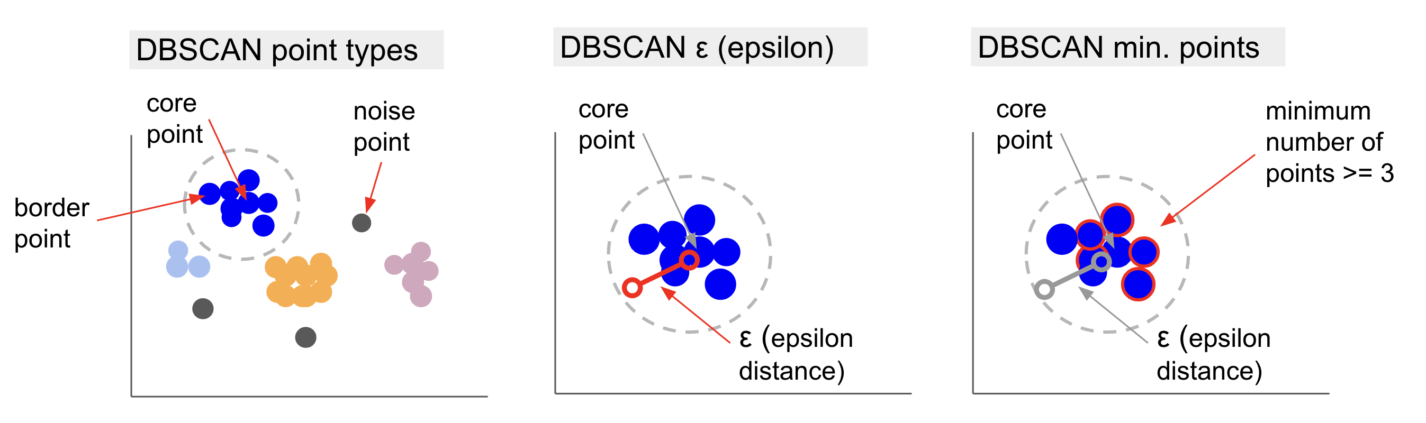
DBSCAN: Core, Border, and Noise Points

Slide 7
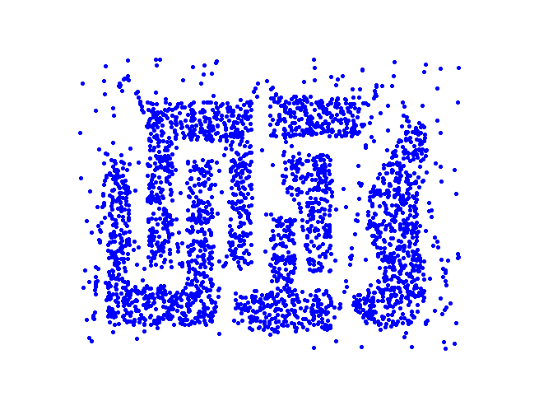
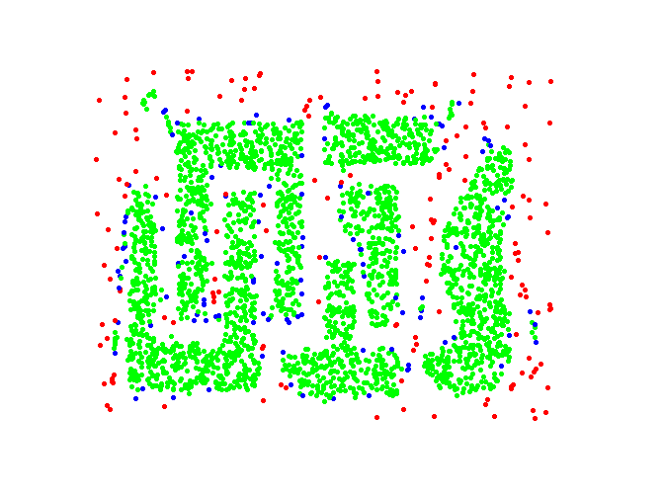
DBSCAN: Core, Border and Noise Points
Original Points
Point types: core, border and noise
Eps = 10, MinPts = 4

Slide 8
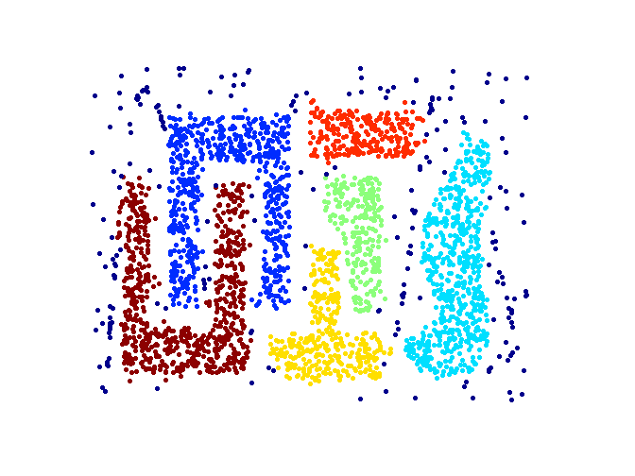
When DBSCAN Works Well
Original Points
Clusters
Resistant to Noise
Can handle clusters of different shapes and sizes

Slide 9
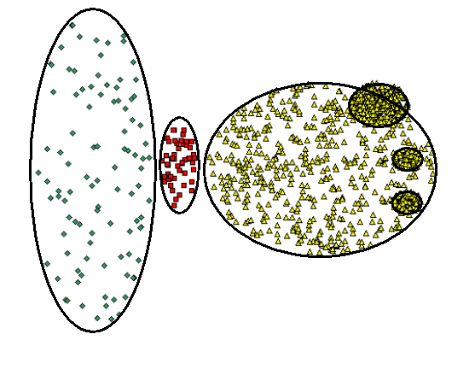
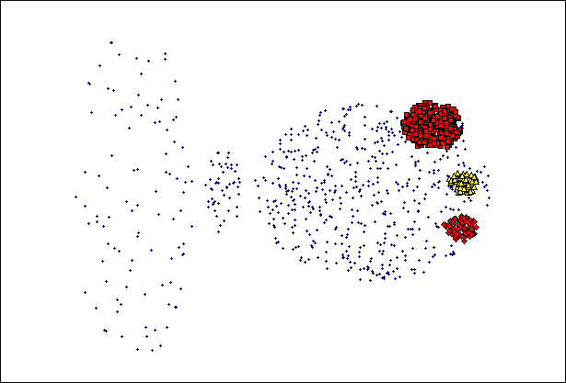
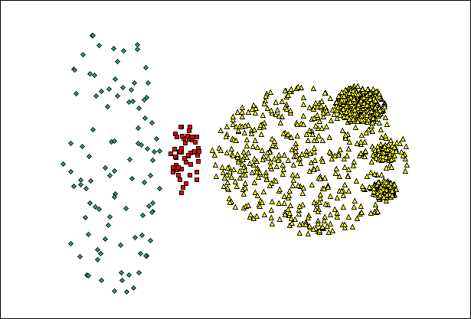
When DBSCAN Does NOT Work Well
(MinPts=4, Eps=9.75).
Original Points
Varying densities
High-dimensional data
(MinPts=4, Eps=9.92)

Slide 10

DBSCAN Visualized (https://www.naftaliharris.com/blog/visualizing-dbscan-clustering/)

Slide 11
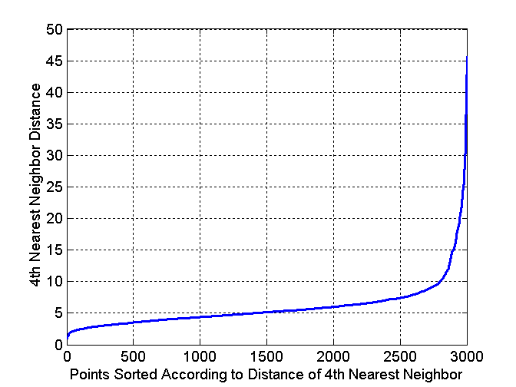
DBSCAN: Determining EPS and MinPts
Choosing Epsilon (ε): Use the K-distance graph; the "elbow" point indicates the optimal value.
Nearest Neighbor Concept: In a cluster, the k-th nearest neighbors are at similar distances.
Noise Points: Their k-th nearest neighbor is farther away.
Finding ε: Plot the sorted distances to the k-th nearest neighbor.
Choosing minPoints: Set it at least one greater than the dataset’s dimensions: minPoints ≥ Dimensions + 1
Notes:
The value of epsilon can be decided from the K-distance graph. The point of maximum curvature (elbow) in this graph tells us about the value of epsilon.
The idea is that for points in a cluster, their k^{th} nearest neighbors are at roughly the same distance.
Noise points have the k^{th} nearest neighbor at a farther distance
So, plot the sorted distance of every point to its k^{th} nearest neighbor
The value of minPoints should be at least one greater than the number of dimensions of the dataset, i.e.,
minPoints >= Dimensions+1.

Slide 12
DBSCAN Advantages and Disadvantages
Advantages:
If we look at its advantages, it is very good at picking up dense areas in data and points that are far from others. This means that the data doesn't have to have a specific shape and can be surrounded by other points if they are also densely connected.
It has two hyperparameters, minimum points and ε, but there is no need to specify the number of clusters, as in K-Means.
It can be used with large databases since it was designed for high-dimensional data.
Disadvantages:
Can’t address different densities in the same cluster
It is also dependent on the distance metric and scaling of the points.
O(nlog(n)) time complexity
DBSCAN Extensions
Other algorithms, such as Hierarchical DBSCAN (HDBSCAN) and Ordering points to identify the clustering structure (OPTICS), are considered extensions of DBSCAN.
HDBSCAN and OPTICS can usually perform better when there are clusters of varying densities in the data and are less sensitive to the choice or initial min points and ε parameters.
Notes:
Advantages:
If we look at its advantages, it is very good at picking up dense areas in data and points that are far from others. This means that the data doesn't have to have a specific shape and can be surrounded by other points if they are also densely connected.
It has two hyperparameters, minimum points and ε, but there is no need to specify the number of clusters, as in K-Means.
It can be used with large databases since it was designed for high-dimensional data.
Disadvantages:
Can’t address different densities in the same cluster
It is also dependent on the distance metric and scaling of the points.
O(nlog(n)) time complexity
DBSCAN Extensions
Other algorithms, such as Hierarchical DBSCAN (HDBSCAN) and Ordering points to identify the clustering structure (OPTICS), are considered extensions of DBSCAN.
HDBSCAN and OPTICS can usually perform better when there are clusters of varying densities in the data and are less sensitive to the choice or initial min points and ε parameters.

Slide 13

DBSCAN Python Example

Slide 14

Appendix

Slide 15
Summary of Selected Clustering Algorithms in Scikit-Learn
Method name | Parameters | Scalability | Usecase | Geometry (metric used)
K-Means | number of clusters | Very large n_samples, medium n_clusters with MiniBatch code | General-purpose, even cluster size, flat geometry, not too many clusters, inductive | Distances between points
Affinity propagation | damping, sample preference | Not scalable with n_samples | Many clusters, uneven cluster size, non-flat geometry, inductive | Graph distance (e.g., nearest-neighbor graph)
Mean-shift | bandwidth | Not scalable with n_samples | Many clusters, uneven cluster size, non-flat geometry, inductive | Distances between points
Spectral clustering | number of clusters | Medium n_samples, small n_clusters | Few clusters, even cluster size, non-flat geometry, transductive | Graph distance (e.g., nearest-neighbor graph)
Ward hierarchical clustering | number of clusters or distance threshold | Large n_samples and n_clusters | Many clusters, possibly connectivity constraints, transductive | Distances between points
Agglomerative clustering | number of clusters or distance threshold, linkage type, distance | Large n_samples and n_clusters | Many clusters, possibly connectivity constraints, non-Euclidean distances, transductive | Any pairwise distance
DBSCAN | neighborhood size | Very large n_samples, medium n_clusters | Non-flat geometry, uneven cluster sizes, outlier removal, transductive | Distances between nearest points
HDBSCAN | minimum cluster membership, minimum point neighbors | large n_samples, medium n_clusters | Non-flat geometry, uneven cluster sizes, outlier removal, transductive, hierarchical, variable cluster density | Distances between nearest points
Gaussian mixtures | many | Not scalable | Flat geometry, good for density estimation, inductive | Mahalanobis distances to centers
BIRCH | branching factor, threshold, optional global clusterer. | Large n_clusters and n_samples | Large dataset, outlier removal, data reduction, inductive | Euclidean distance between points

Slide 16
Distance Measures
Minkowski Distance (http://en.wikipedia.org/wiki/Minkowski_distance)
For
p = 1: Manhattan (city block) distance
p = 2: Euclidean distance
Do not confuse p with n, i.e., all these distances are defined based on all numbers of features (dimensions).
A generic measure: use appropriate p in different applications

Slide 17
References
https://towardsdatascience.com/the-5-clustering-algorithms-data-scientists-need-to-know-a36d136ef68
https://www.geeksforgeeks.org/ml-k-medoids-clustering-with-example/
https://www.analyticsvidhya.com/blog/2021/06/kmodes-clustering-algorithm-for-categorical-data/#h-what-is-kmodes
https://towardsdatascience.com/the-k-prototype-as-clustering-algorithm-for-mixed-data-type-categorical-and-numerical-fe7c50538ebb
http://scikit-learn.org/stable/modules/clustering.html
https://citeseerx.ist.psu.edu/viewdoc/download?doi=10.1.1.15.4028&rep=rep1&type=pdf
https://github.com/nicodv/kmodes/blob/master/kmodes/kprototypes.py
https://dashee87.github.io/data%20science/general/Clustering-with-Scikit-with-GIFs/
https://www.geeksforgeeks.org/difference-between-agglomerative-clustering-and-divisive-clustering/
https://stackabuse.com/dbscan-with-scikit-learn-in-python/

